Slide 1
SQL INJECTION

Slide 2
INTRODUCTION
SQL Injection attacks allow a malicious individual to execute arbitrary SQL code on your server
The attack could involve a change in the original SQL query
Logic ' OR 1 = 1; --
Semantics ; DELETE FROM users; --
Syntax ' ''

Slide 3
TYPES
SQL Manipulation
Modify the original SQL query by including additional queries
Inclusion of conditional statement in where clause
“Select * from Table where Username=’ ‘ and password=’ ‘”
“Select * from Table where Username=’ ‘or ‘c’=’c’ -- and password=’ ‘”
Use UNION, INTERSECT
Select * from projects where projecttype=’ ‘
Select * from project where projectType=’ ‘ UNION Select * from school

Slide 4
TYPES
Code Injection
Insert new SQL commands into the original SQL query
Select * from users where username=’ ‘can be modified to
Select * from users where username =’ ‘; drop table faculty

Slide 5
TYPES
Incorrect Queries
By inserting logical errors into the query, attackers get hold of the error information
The error information often reveal names of the tables and columns that caused the error
”Microsoft OLE DB Provider for SQL Server (0x80040E07) Error converting nvarchar value ’CreditCards’ to a column of data type int.”

Slide 6
TYPES
Function Call Injection
An attacker can inject different database and operating system functions in a SQL statement
“Select * from Table where Username=’ ‘ and password=’ ‘” can be modified to
“Select * from Table where Username=’ ‘shutdown with nowait; -- and password=’ ‘”
SHUTDOWN WITH NO WAIT causes SQL server to shut down, stopping Windows Service

Slide 7
PREVENTION
Sanitize Input Data
Input validation for length, type, format and range
For example, you could remove single quotes, backslashes, and semicolons.
Check length of user input
Privilege Restrictions
Restrict functions that are not necessary for the application
For example, you could only give users the ability to read data, not write or delete data.

Slide 8
PREVENTION
Use SQL parameters
Stored Procedures and Dynamic SQL with parameters
For example Use Place holder in query %s
Avoid error disclosure
Reveal minimalistic information to client about the error
For example, you could log errors to a file instead of displaying them to the user.

Slide 9
DEMO
DEMO

Slide 10
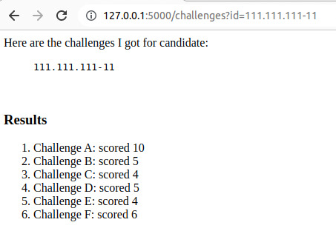
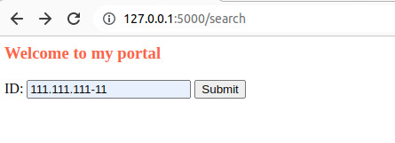
expected use

Slide 11
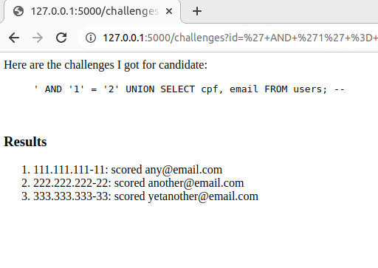
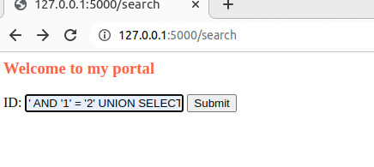
Use union select to query data from other tables

Slide 12
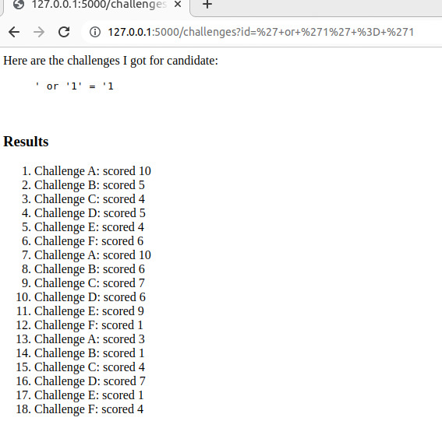
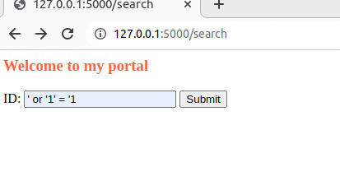
Or Statement use

Slide 13
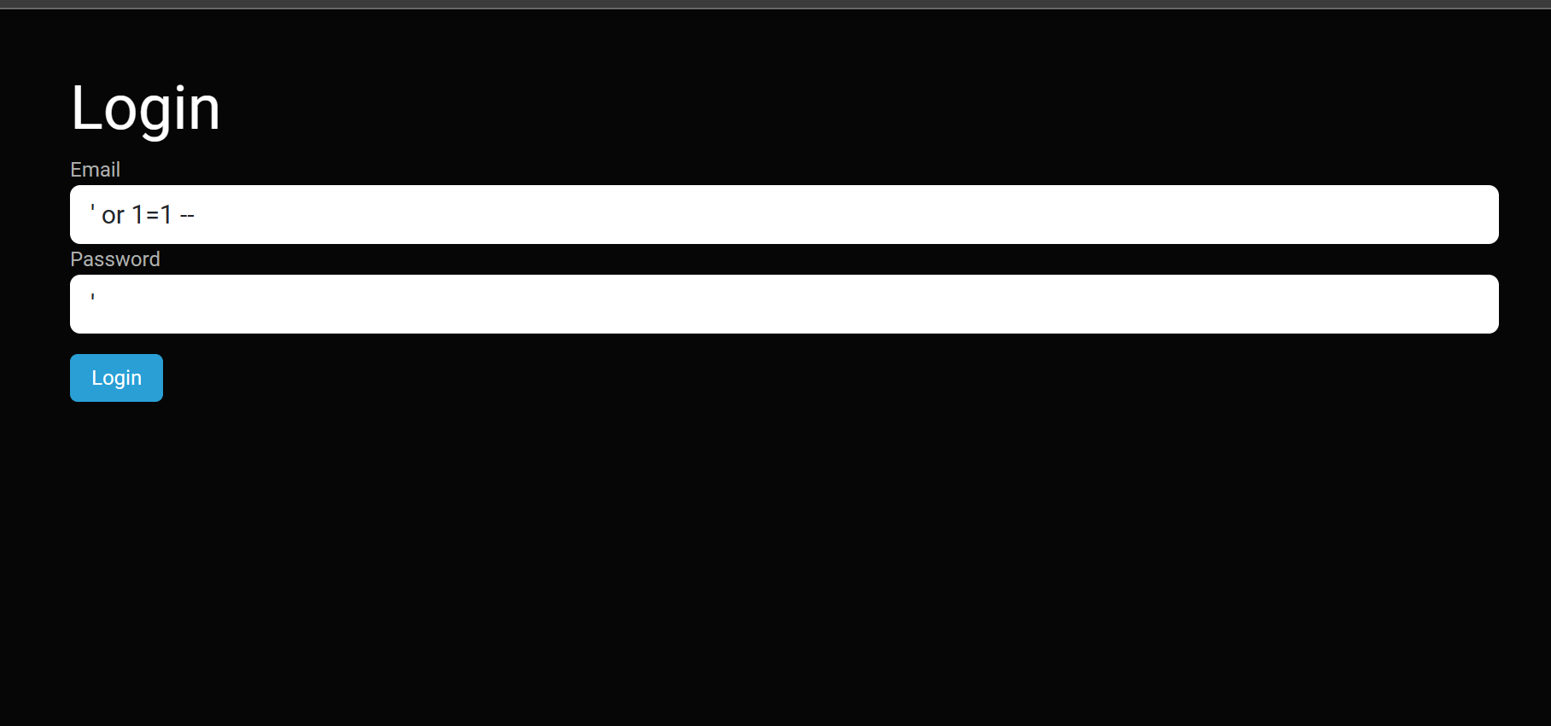
Demo

Slide 14
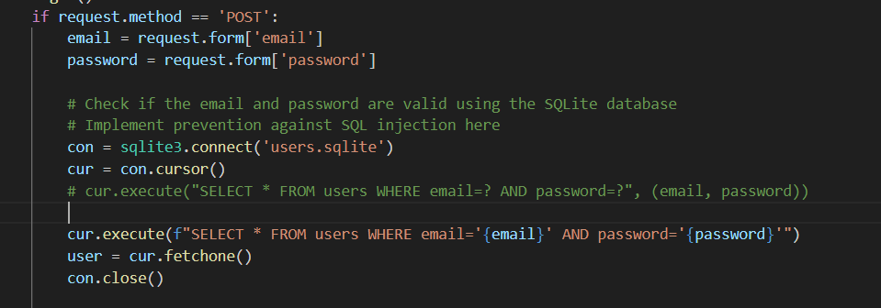
Demo

Slide 15
SQLMAP Demo
Querry
Python sqlmap.py -u http://127.0.0.1:5000/ --method POST --data "email=test@gmail.com&password=test"

Slide 16
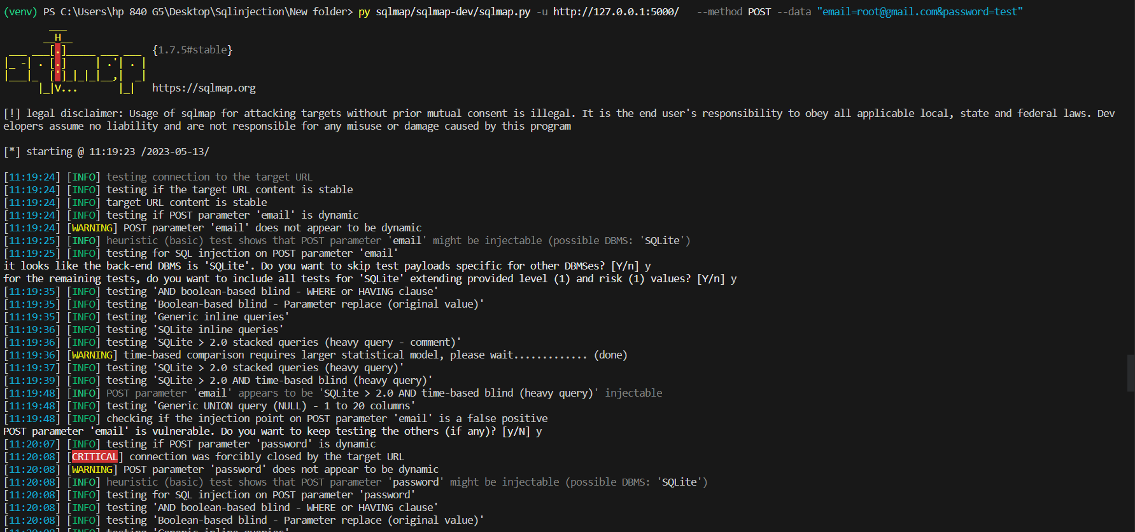
SQL MAP

Slide 17
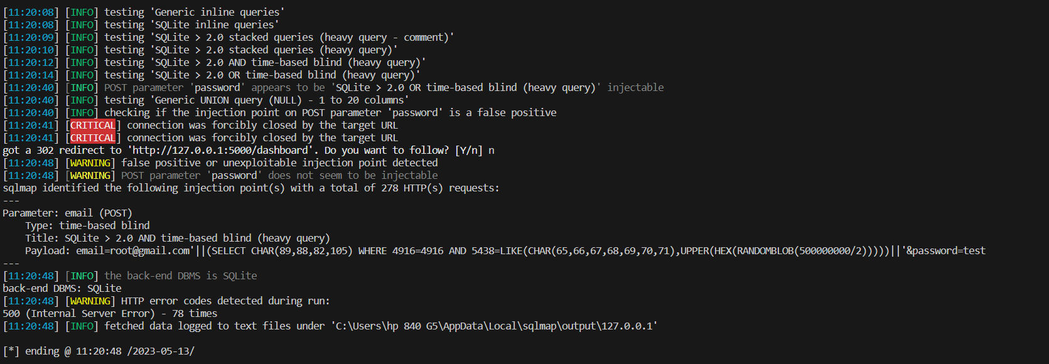
SQL Map

Slide 18
SQL MAp
sqlmap.py -u http://127.0.0.1:5000/ --method POST --data "email=test@gmail.com&password=test" --tables --dump

Slide 19
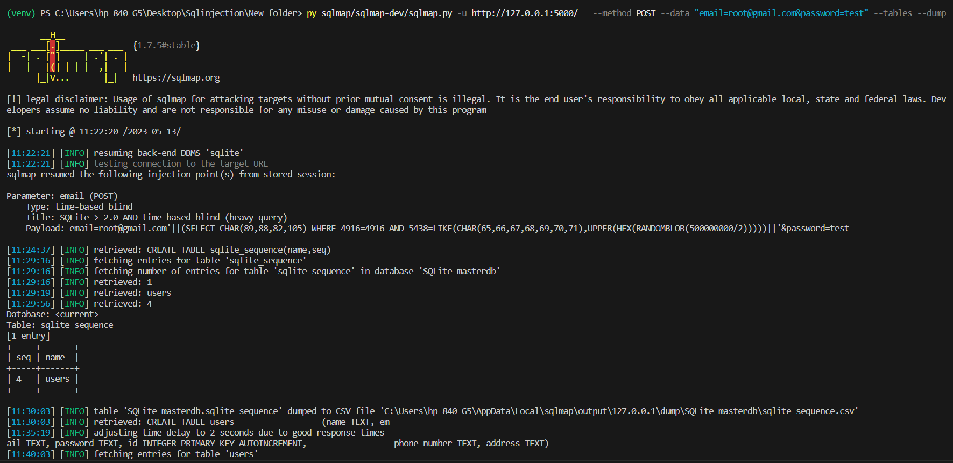
SQLMAP

Slide 20
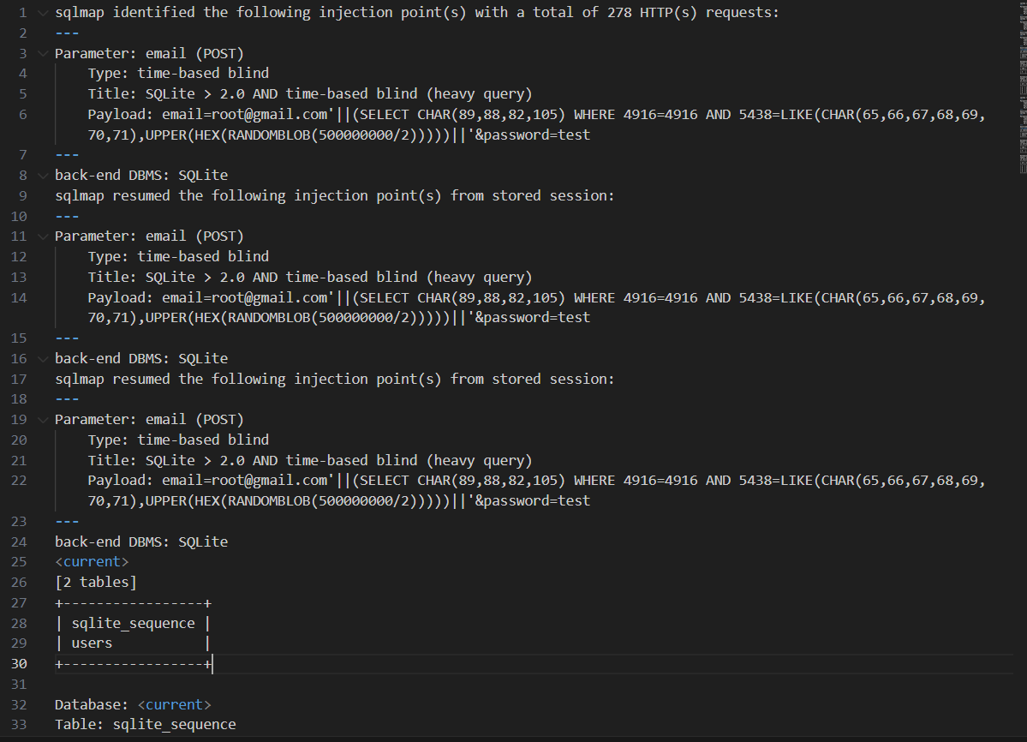
SQLMAP LOG

Slide 21
SQLMAP LOG

Slide 22
THANK YOU

